Slide 1

SAMSUNG PRISM
Generative AI
Hackathon
3rd Edition 2026 – 27
Theme ID - 4
Team Name – Big Leagues
College Name – SRM Institute of Science & Technology
Member Name & Email 1- 9205773552 ab3302@srmist.edu.in
Member Name & Email 2- 8700072727 as4715@srmist.edu.in
Member Name & Email 3- 8882728322 as3089@srmist.edu.in
Member Name & Email 4- 8972182034 tt6331@srmist.edu.in
Submission Github link - https://github.com/Aniketbisht31/PRISM_GENAI_HACKATHON_Y2026

Slide 2
Theme
Theme 04: Streaming Live RAG
Real-time answers from live speech, grounded in the corpus.
Our engine starts searching before the user finishes speaking, splits one natural request into the questions it actually contains, updates the answer in place when new details arrive, and cites every claim.

Slide 3
Existing Solutions & Gaps
Existing approach | What it does well | Gap | How we close it
Batch RAG | Simple, reliable retrieval after the user finishes | Waits for the full utterance; one query per turn | Controller decides WAIT / RETRIEVE / NO_RETRIEVAL on every chunk, so search starts mid-sentence
Multi-query / query-rewriting RAG | Better recall on complex questions | Runs after the utterance ends; rewrites from scratch each turn | Decomposes into up to 4 sub-queries in parallel while the user is still speaking
Per-token or per-chunk retrieval | Low latency | Fires on incomplete thoughts, so it adds noise and cost | Retrieves only once the intent is stable, not on every token
Chat memory plus re-retrieval | Keeps conversational context | A late detail often triggers a full re-search | Delta retrieval updates the existing answer and bumps its version, keeping earlier citations
LLM answers with citations | Readable, sourced-looking output | Citations can be fabricated or not actually supported | Each sentence needs an exact source excerpt, otherwise it is removed or flagged as uncertain
Agent-framework orchestration | Flexible | Heavy and slow, with hard-to-justify overhead | Plain FastAPI pipeline, local embeddings, cost and latency traced per turn

Slide 4
Our Solutions & Architecture Diagram
Our solution: a four-stage streaming pipeline that decides when to search, what to search for, and what it can prove.
Controller: after every transcript chunk, it chooses WAIT, RETRIEVE or NO_RETRIEVAL, so search starts mid-sentence only once the intent is stable.
Decomposer: splits one natural request into up to 4 sub-queries and searches them in parallel.
Hybrid retrieval: combines dense (ChromaDB) and BM25 results with rank fusion and removes duplicate sections, all from the supplied corpus.
Grounded synthesis: every sentence must carry a [Doc_ID §Section] citation backed by an exact source excerpt, otherwise it is removed or flagged as uncertain.

Slide 5
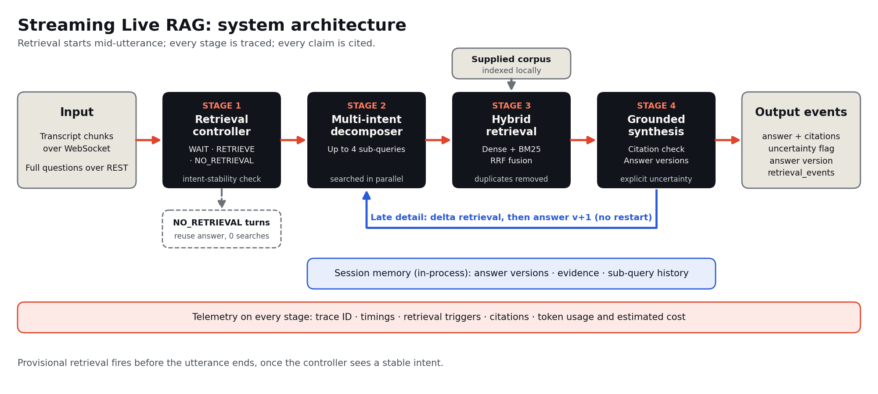
Architecture Diagram

Slide 6
Demo & Product Walkthrough
One conversation, six proof points (video:- https://drive.google.com/file/d/1RryWacdLqB5szCqar0apQAq6f_hGNlxm/view?usp=sharing)
Early retrieval: transcript chunks stream in over WebSocket, and search starts before the user finishes speaking.
Multi-intent split: one request becomes separate sub-queries, searched in parallel.
Refine, never restart: a late detail updates the answer to version 2, with earlier citations kept.
Skip the search: "make that shorter" reuses the verified answer with zero corpus queries.
Citations and uncertainty: each claim traces to a [Doc_ID §Section] source, and a question the corpus can't answer gets an uncertainty flag instead of a guess.
Live telemetry: trace IDs, per-stage timings and token cost for every turn.
Repo: [https://github.com/Aniketbisht31/PRISM_GENAI_HACKATHON_Y2026]

Slide 7
Tools and tech stack used
Layer | Tools | Why we chose it
API and streaming | Python 3.11, FastAPI, WebSocket | One service handles full questions (REST) and live transcript chunks (WebSocket)
Dense retrieval | ChromaDB, all-MiniLM-L6-v2 | Small local model and local index, so the corpus and embeddings never leave the machine
Sparse retrieval | BM25 | Catches exact keywords and names that embeddings can miss
Fusion | Reciprocal rank fusion, section dedupe | Combines rankings across sub-queries without a heavy reranker
Language model | Ollama (local) or Groq | Used for controller decisions, decomposition and synthesis. One variable switches between private local inference and fast hosted inference
Grounding | Exact-excerpt validator, uncertainty fallback | Unsupported claims are removed or flagged, never invented
Telemetry | JSONL event log, /api/telemetry/report | Timings, retrieval triggers, answer-version lineage and cost for every turn
Packaging and QA | Docker Compose, pytest, eval/run_gates, ablation runner | One-command run, offline tests, measured acceptance gates

Slide 8
Impact & Use case
Use Case
Real-time voice and chat assistant for workshop and event planning
A planner dictates a request: "Customer workshop in Pune, 30 people, I need the cancellation policy and the catering options..."
The system starts retrieving while the user is still speaking, instead of waiting for the full question.
Compound requests are split into up to 4 subqueries, retrieved in parallel.
Late details ("it's during monsoon season") refine the existing answer without restarting.
Follow-ups like "shorten that" or "translate that" reuse the answer with zero new retrieval.
Where it applies beyond workshops: customer-support call assistants, live voice agents, internal policy and knowledge-base Q&A, and venue or vendor booking desks.

Slide 9
Use case
Area | What it delivers
Lower latency | Provisional retrieval starts mid-utterance, so evidence is ready when the user finishes
Trustworthy answers | Every factual claim carries a [Doc_ID §Section] citation with an exact source excerpt; unsupported claims are removed
Honest uncertainty | If the corpus can't support an answer, the system says so instead of guessing
Lower compute cost | Presentation-only requests skip retrieval; Ollama runs at zero provider cost
Privacy control | Corpus, vector index, and embeddings stay local; choose Ollama (local) or Groq (cloud) by data needs
Full observability | Per-request trace IDs, retrieval timings, token usage, cost estimates, and answer lineage
Measurable quality | 6 evaluation gates (G1–G6) over 72 test cases covering early retrieval, decomposition, citation support, and trace coverage
Impact

Slide 10
Innovation highlights, results and limitations
Innovation Highlights
Retrieval before the sentence ends. A controller reads the growing transcript and decides WAIT, RETRIEVE, or NO_RETRIEVAL after every chunk, so search can start mid-utterance.
Multi-intent decomposition. Compound requests split into up to 4 subqueries, retrieved in parallel.
Hybrid retrieval. Dense (all-MiniLM-L6-v2 + ChromaDB) and sparse (BM25) results are merged with reciprocal rank fusion, with repeated sections removed.
Late-detail refinement. New details trigger delta retrieval and produce a new answer version, with no restart.
Zero-retrieval presentation turns. "Shorten that" or "translate that" reuses prior citations and never calls the retriever.
Grounding by design. Exact-excerpt checks, per-sentence citations, and named-venue validation remove unsupported claims, and the system falls back to uncertainty rather than model knowledge.
Built-in observability. Trace IDs, timings, token usage, cost estimates, and answer lineage for every request.

Slide 11
results
Gate | Target
G2: Early retrieval | ≥ 80% early retrieval, ≤ 10% false triggers
G3: Decomposition | ≥ 70% of compound cases yield multiple subqueries
G4: Citations | ≥ 85% supported, 0 unsupported assertions, 0 fabricated IDs
G5: Refinement and presentation | ≥ 80% pass rate
G6: Traces and cost | 100% complete traces, no unknown costs
72 live evaluation cases, with offline tests covering controller, retrieval, grounding, REST/WebSocket, and telemetry.
A paired REST vs WebSocket baseline measures time to first retrieval and final latency.

Slide 12
limitations
Sessions are in-memory. They are lost on restart and not shared across workers.
No built-in auth, session expiry, or multi-tenant isolation. Production use needs a gateway and a shared session store.
Strict exact-quote checks. They favor precision and may reject valid paraphrases, and they do not prove semantic entailment.
Narrow corpus. 19 records across 15 documents on workshop planning, so results don't generalize to other domains.
Provider dependence. Groq quotas (HTTP 429) can leave traces incomplete, and live gates can't verify G1 (clean Docker build) on their own.
Small-sample evidence. Ablation results are historical, and small baseline samples don't establish production performance.

Slide 13
What’s next
Near term: harden for production
Shared session store (e.g., Redis) with an expiration policy, so answers survive restarts and work across workers and replicas.
Authentication and authorization through a gateway, plus multi-tenant isolation.
Telemetry retention policy and protected log storage, since logs contain user queries.
Mid term: improve answer quality
Semantic entailment checks alongside exact-quote validation, so valid paraphrases are no longer rejected.
Publish live gate results (G1-G6) and the REST vs WebSocket latency baseline with the backend, model, and run date recorded.
Current ablation benchmarks for hybrid vs dense-only retrieval and rule-based vs model-based control, replacing the historical numbers.
Longer term: broaden scope
Larger, multi-domain corpus with evaluation fixtures beyond workshop planning, so results can generalize.
Real speech input. Connect a speech-to-text front end to the WebSocket stream for true live voice use.
Quota-resilient inference with fallback between Ollama and Groq, so provider limits don't leave traces incomplete.
Recorded demo and dashboards built on the existing telemetry (cost, latency, citation support).

Slide 14
Brownie points slide( differentiation)
Typical RAG demo | Streaming Live RAG
Waits for the full question, then searches | Starts retrieval mid-utterance via a WAIT / RETRIEVE / NO_RETRIEVAL controller
One query, one search | Up to 4 subqueries from compound requests, retrieved in parallel
Follow-ups re-run the whole pipeline | Late details refine the existing answer; "shorten that" skips retrieval entirely
Fluent answers, hard to verify | Exact-excerpt citations [Doc_ID §Section]; unsupported claims removed
Guesses when evidence is thin | Says "uncertain" instead of falling back on model knowledge
Black box | Trace IDs, token usage, cost estimates, answer lineage per request
Cloud-only or local-only | Switchable backend: Ollama (local, zero provider cost) or Groq (cloud)

Slide 15
Evaluation built in: 6 gates (G1-G6) over 72 live cases, plus offline tests with mocked providers.
Honest benchmarking: A paired REST vs WebSocket baseline and component ablations (hybrid vs dense-only, rule-based vs model-based control).
Privacy-aware design: Corpus, index, and embeddings stay local; the README spells out what leaves the machine for each backend.
Production-minded: Docker Compose, clean-build test replay, and documented limitations rather than hidden ones.
Transparent about gaps: Known limitations are stated openly, which builds credibility.

Slide 16
Checklist- Updated on Public GitHub
Working prototype code — public or shared GitHub repo (Y/)
README with reproducible setup instructions (Y/)
Demo video, max 5 minutes (YouTube or Drive link)(Y)
Presentation file (PPT or PDF) (Y/)

Slide 17
Thank you
Organised by the Language AI Team and the PRISM Team, Samsung R&D Institute India
Notes:
Closing slide. Add the Google Form URL and a contact email before sharing. Edition 2 organising team for reference: Language AI - Sourabh Tiwari, Gaurav, Sanjeeth Pothireddy, Gorang Maniar; PRISM - Binny Lakra, Prakhar Chandrakar, Vishu Kumar; Kick-off and mentors - Giridhar Jakki, Deepraj Prabhakar Patkar (Language AI), Srimanu Prasad Nagaraju, Ashish Kumar (Tech Strategy).

